Slide 1
Object-Oriented Systems Development:
Using the Unified Modeling Language
Chapter 7:
Object Analysis: Classification
Object-Oriented Systems Development Bahrami © Irwin/ McGraw-Hill

Slide 2

Goals
The concept of classification.
How to identify classes with the noun phrase approach.
How to identify classes with the common class patterns approach.
Object-Oriented Systems Development Bahrami © Irwin/ McGraw-Hill

Slide 3
Goals (Con’t)
How to identify classes and object behavior analyzed by sequence/collaboration modeling.
Class responsibilities collaboration (CRC) approach.
Object-Oriented Systems Development Bahrami © Irwin/ McGraw-Hill

Slide 4

... Intelligent classification is intellectually hard work, and it best comes about through an incremental and iterative process
Booch
Object-Oriented Systems Development Bahrami © Irwin/ McGraw-Hill

Slide 5

..There is no such thing as the perfect class structure, nor the right set of objects. As in any engineering discipline, our design choice is compromisingly shaped by many competing factors.
Booch
Object-Oriented Systems Development Bahrami © Irwin/ McGraw-Hill

Slide 6

Classification Theory
Classification is the process of checking to see if an object belongs to a category or a class and it is regarded as a basic attribute of human nature.
Object-Oriented Systems Development Bahrami © Irwin/ McGraw-Hill

Slide 7
A
B
C
D
E
F
Object-Oriented Systems Development Bahrami © Irwin/ McGraw-Hill
Notes:
This Figure contains 6 items, labeled A to F, each of which represents a train. Each train includes an engine ( on the right) and form two to four cars. Each shaped differently and holding different loads.
Ask your students to arrange them into any number of groups using their own criteria.
Ask them what criteria did they use to group these trains.
Once they have completed this task, change the requirements. Let’s assume the circle represents toxic chemicals. Now ask them to classify the trains again.

Slide 8

Point To Remember
Two Issues
A class is a specification of structure, behavior, and the description of an object.
Classification is more concerned with identifying classes than identifying the individual objects in a system.
Object-Oriented Systems Development Bahrami © Irwin/ McGraw-Hill

Slide 9

The Challenge of Classification
Intelligent classification is intellectually hard work and may seem rather arbitrary.
Martin and Odell have observed in object-oriented analysis and design, that
  “In fact, an object can be categorized in more than one way.”
Object-Oriented Systems Development Bahrami © Irwin/ McGraw-Hill

Slide 10
Employer
Employee
Pet Owner
Good Credit Risk
Object-Oriented Systems Development Bahrami © Irwin/ McGraw-Hill
Notes:
The same object, Betty, can be classified in many ways.

Slide 11
Approaches for Identifying Classes
The noun phrase approach.
The common class patterns approach.
The use-case driven approach.
The class responsibilities collaboration (CRC) approach.
Object-Oriented Systems Development Bahrami © Irwin/ McGraw-Hill

Slide 12

Noun Phrase Approach
Using this method, you have to read through the Use cases, interviews, and requirements specification carefully, looking for noun phrases.
Object-Oriented Systems Development Bahrami © Irwin/ McGraw-Hill

Slide 13
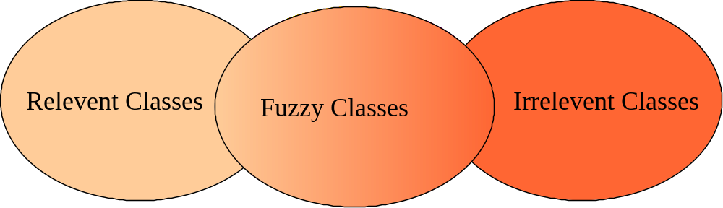
Noun Phrase Strategy (Con’t)
Change all plurals to singular and make a list, which can then be divided into three categories.
Object-Oriented Systems Development Bahrami © Irwin/ McGraw-Hill

Slide 14
Noun Phrase Strategy (Con’t)
It is safe to scrap the Irrelevant Classes.
You must be able to formulate a statement of purpose for each candidate class; if not, simply eliminate it.
You must then select candidate classes from the other two categories.
Object-Oriented Systems Development Bahrami © Irwin/ McGraw-Hill

Slide 15
Guidelines For Identifying Classes
The followings are guidelines for selecting classes in your application:
Look for nouns and noun phrases in the problem statement.
Some classes are implicit or taken from general knowledge.
Object-Oriented Systems Development Bahrami © Irwin/ McGraw-Hill

Slide 16
Guidelines For Identifying Classes (Con’t)
All classes must make sense in the application domain.
Avoid computer implementation classes, defer it to the design stage.
Carefully choose and define class names.
Object-Oriented Systems Development Bahrami © Irwin/ McGraw-Hill

Slide 17

Guidelines For Refining Classes
Redundant Classes:
Do not keep two classes that express the same information.
If more than one word is being used to describe the same idea, select the one that is the most meaningful in the context of the system.
Object-Oriented Systems Development Bahrami © Irwin/ McGraw-Hill

Slide 18

Guidelines For Refining Classes (Con’t)
Adjective Classes:
Does the object represented by the noun behave differently when the adjective is applied to it?
Object-Oriented Systems Development Bahrami © Irwin/ McGraw-Hill

Slide 19
Guidelines For Refining Classes (Con’t)
If the use of the adjective signals that the behavior of the object is different, then make a new class.
For example, If Adult Membership and Youth Membership behave differently, than they should be classified as different classes.
Object-Oriented Systems Development Bahrami © Irwin/ McGraw-Hill

Slide 20
Guidelines For Refining Classes (Con’t)
Attribute Classes:
Tentative objects which are used only as values should be defined or restated as attributes and not as a class.
For example the demographics of Membership are not classes but attributes of the Membership class.
Object-Oriented Systems Development Bahrami © Irwin/ McGraw-Hill

Slide 21

Guidelines For Refining Classes (Con’t)
Irrelevant Classes:
Each class must have a purpose and every class should be clearly defined and necessary.
If you cannot come up with a statement of purpose, simply eliminate the candidate class.
Object-Oriented Systems Development Bahrami © Irwin/ McGraw-Hill

Slide 22

Common Class Patterns Approach
This approach is based on the knowledge-base of the common classes that have been proposed by various researchers.
Object-Oriented Systems Development Bahrami © Irwin/ McGraw-Hill

Slide 23

Candidate Classes - Events
These are points in time that must be recorded and remembered.
Things happen, usually to something else, at a given date and time, or as a step in an ordered sequence.
For example order which is an event that must be remembered.
Object-Oriented Systems Development Bahrami © Irwin/ McGraw-Hill

Slide 24

Candidate Classes - Organization
The organizational units that people belong to.
For example, accounting department might be considered as a potential class.
Object-Oriented Systems Development Bahrami © Irwin/ McGraw-Hill

Slide 25

Candidate Classes - People and Person (Roles and Roles Played)
The different roles users play in interacting with the application.
Object-Oriented Systems Development Bahrami © Irwin/ McGraw-Hill

Slide 26

Candidate Classes - People (Con’t)
It can be divided into two types (Coad & Yourdon):
Those representing users of the system, such as an operator, or a clerk;
Object-Oriented Systems Development Bahrami © Irwin/ McGraw-Hill

Slide 27

Candidate Classes - People (Con’t)
Those people who do not use the system but about whom information is kept.
  Some examples are Client, Employee, Teacher, Manager.
Object-Oriented Systems Development Bahrami © Irwin/ McGraw-Hill

Slide 28

Candidate Classes - Places
These are physical locations, such as buildings, stores, sites or offices that the system must keep information about.
Object-Oriented Systems Development Bahrami © Irwin/ McGraw-Hill

Slide 29

Candidate Classes - Tangible Things and Devices
Physical objects, or group of objects, that are tangible, and devices with which the application interacts.
For example, cars, pressure sensors.
Object-Oriented Systems Development Bahrami © Irwin/ McGraw-Hill

Slide 30

Candidate Classes - Concepts
Concepts are principles or ideas not tangible but used to organize or keep track of business activities and/or communications.
Object-Oriented Systems Development Bahrami © Irwin/ McGraw-Hill

Slide 31
Use-case Driven Approach
Once the system has been described in terms of its scenarios, we can examine the textual description or steps of each scenario to determine what objects are needed for the scenario to occur.
Object-Oriented Systems Development Bahrami © Irwin/ McGraw-Hill
Notes:
The third method to identify classes in a system is use-case driven approach .

Slide 32
Use-case Driven Approach
To identify objects of a system and their behaviors, the lowest level of executable use cases is further analyzed with a sequence and collaboration diagram pair.
By walking through the steps, you can determine what objects are necessary for the steps to take place.
Object-Oriented Systems Development Bahrami © Irwin/ McGraw-Hill

Slide 33
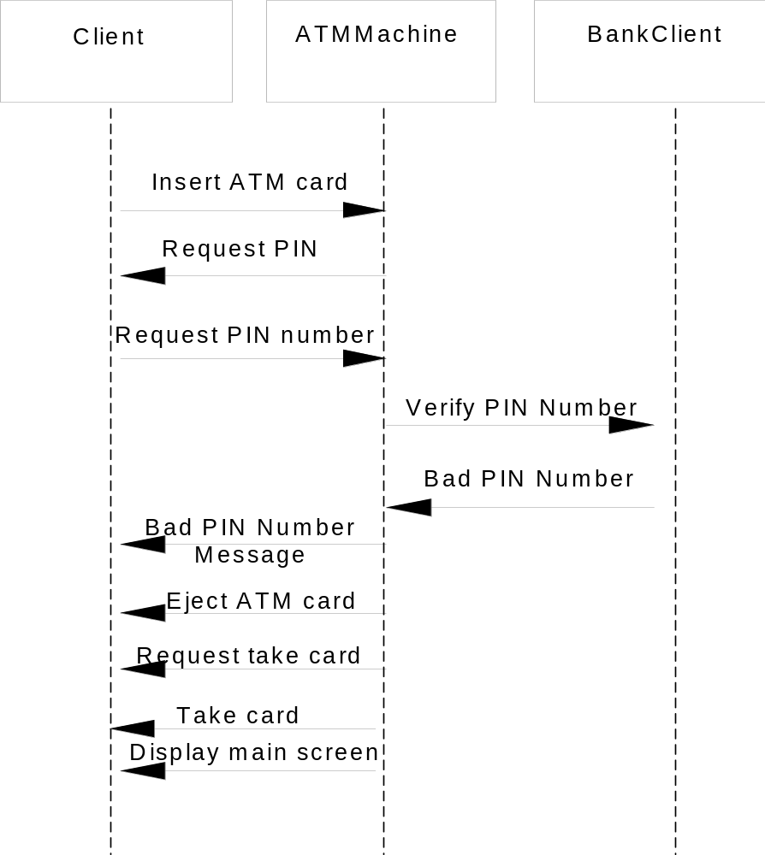
Object-Oriented Systems Development Bahrami © Irwin/ McGraw-Hill
Notes:
The sequence diagram for the Invalid PIN use case.

Slide 34
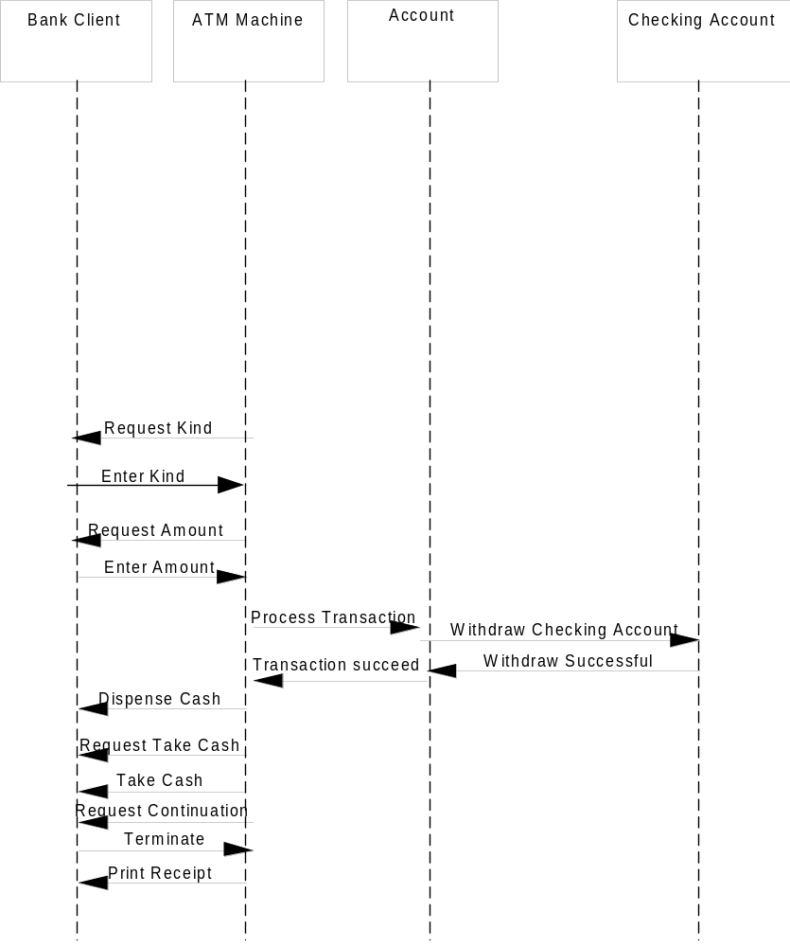
Object-Oriented Systems Development Bahrami © Irwin/ McGraw-Hill
Notes:
Sequence diagram for the withdraw Checking use case.

Slide 35
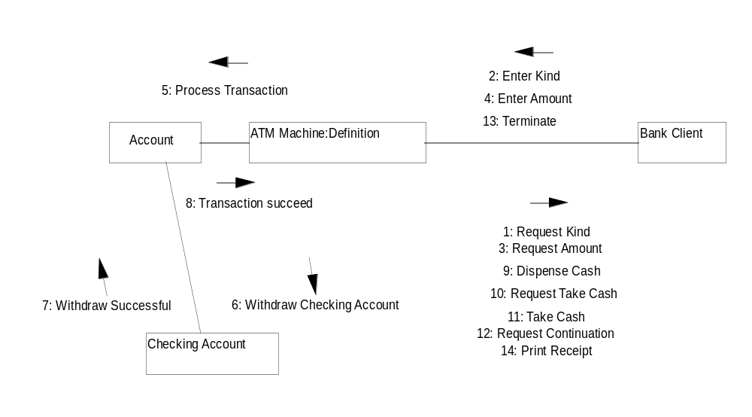
Object-Oriented Systems Development Bahrami © Irwin/ McGraw-Hill
Notes:
The collaboration diagram for the withdraw checking use-case.

Slide 36

CRC Cards
CRC stands for Class, Responsibilities and Collaborators developed by Cunningham, Wilkerson and Beck.
CRC can be used for identifying classes and their responsibilities.
Object-Oriented Systems Development Bahrami © Irwin/ McGraw-Hill

Slide 37
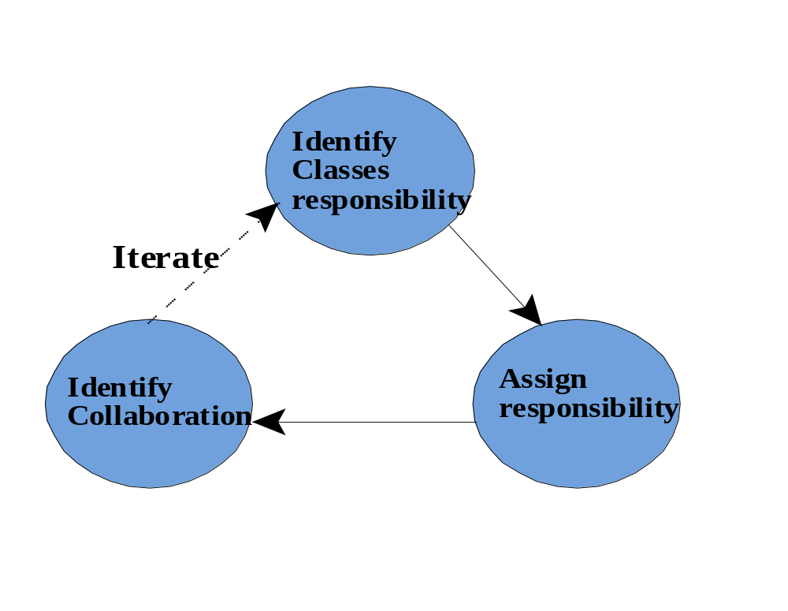
Process of the CRC Technique
Object-Oriented Systems Development Bahrami © Irwin/ McGraw-Hill

Slide 38

Collaborations
An object can accomplish either a certain responsibility itself, or it may require the assistance of other objects.
If it requires an assistance of other objects, it must collaborate with those objects to fulfill its responsibility.
Object-Oriented Systems Development Bahrami © Irwin/ McGraw-Hill

Slide 39
CRC Cards (Con’t)
CRC cards are 4" x 6" index cards. All the information for an object is written on a card.
...
ClassName
Collaborators
...
Responsibilities
Object-Oriented Systems Development Bahrami © Irwin/ McGraw-Hill

Slide 40
CRC Cards (Con’t)
CRC starts with only one or two obvious cards.
If the situation calls for a responsibility not already covered by one of the objects:
  Add, or
  Create a new object to address that responsibility.
Object-Oriented Systems Development Bahrami © Irwin/ McGraw-Hill

Slide 41
Guidelines for Naming Classes
The class should describe a single object, so it should be the singular form of noun.
Use names that the users are comfortable with.
The name of a class should reflect its intrinsic nature.
Object-Oriented Systems Development Bahrami © Irwin/ McGraw-Hill

Slide 42
Guidelines for Naming Classes (Con’t)
By the convention, the class name must begin with an upper case letter.
For compound words, capitalize the first letter of each word - for example, LoanWindow.
Object-Oriented Systems Development Bahrami © Irwin/ McGraw-Hill

Slide 43

Summary
Finding classes is not easy.
The more practice you have, the better you get at identifying classes.
There is no such thing as the “right set of classes.”
Finding classes is an incremental and iterative process.
Object-Oriented Systems Development Bahrami © Irwin/ McGraw-Hill

Slide 44
Summary (Con’t)
Unless you are starting with a lot of domain knowledge, you are probably missing more classes than you will eliminate.
Naming a class is also an important activity.
The class should describe a single object, so it should be a singular noun or an adjective and a noun.
Object-Oriented Systems Development Bahrami © Irwin/ McGraw-Hill

